Slide 1
Capture Plan
Prepared by:
For Opportunity:
Last Updated:
Notes:
Identify opportunity
List preparer.
Update frequently.
Consider a system that highlights changes for those familiar with prior versions.

Slide 2
Executive Overview
Program Overview
Customer Overview
Competitive Position Summary
Summary of Our Solution
Capture Strategy
Status
Notes:
Program overview
Summarize the services and products sought. Note the estimated contract value and duration.
Customer overview
Summarize key customer information.
Competitive position summary
List and rank competitors from the customer’s perspective.
List incumbent(s) and teaming combinations, as applicable.
Link rankings to the Bidder Comparison Chart.
Summary of your solution
Outline major solution elements.
Indicate the potential or actual team, as appropriate.
Capture strategy
List 3-5 over-arching approaches planned to position your organization and solution as the preferred option.
Status
Summarize current capture efforts.
Highlight near-term critical tasks, milestones, and required decisions.
Update frequently.

Slide 3
EXTERNAL ANALYSIS
Opportunity Description
Elements | Description
Customer
Program Summary
Key Requirements
Deliverables
Budget and Fiscal-Year Funding Profile
Schedule
Type of Contract
Other: (Specify)
Notes:
Customer
List the buying organization. Be specific, citing the agency, branch, division, or department. Cite the parent organization, if applicable.
Program summary
Summarize what is wanted, the customer’s envisioned services and/or products.
Cite the customer’s vision and desired outcome: What problem is being solved, pain alleviated, or need satisfied?
Cite program objectives, if available.
Key requirements
List requirements by category:
Technical
Management
Key personnel
Past performance
Cost/price, terms, warranties
Security
Add or delete categories as appropriate.
Deliverables
Services
Products
Data
Budget and fiscal year funding profile
Amount
Sources (who pays or has the budget)
Types of funds
Timing of funding
Schedule
List known buying milestone dates:
Industry day
Bidders’ conference
Site visits
Draft and final solicitation release
Question deadline
Proposal submittal
Oral presentations
Contract award
Project initiation
Highlight near-term dates and update frequently.
Type of contract
List the type of contract.
Note if a single or multiple award(s).
Provide actual or estimated total contract value.
Specify contract value by time period.
Identify length of contract and renewal options.
Other
Cite special provisions (data rights ownership, warranties, performance warranties, bonding, insurance).
Organizational conflict of interest.
Small, minority, or disadvantaged business requirements.

Slide 4
EXTERNAL ANALYSIS
Customer Profile
Organization and Key Personnel
Purchasing or Buying Process
Evaluation Process
Buying History and Trends
Notes:
Organization and key personnel
Describe the organization. Insert or reference organization charts. Good general sources are often available on customers’ websites.
Ask customers to describe their internal structure, especially the immediate buying and user organizations.
List key personnel.
Classify personnel as decision makers, influencers, gatekeepers, or potential coaches.
Purchasing or buying process
Outline this customer’s buying process and how it is managed.
Note the current position in the buying process.
Evaluation process
Describe or diagram evaluation steps.
Link dates to the steps.
Name and describe probable evaluators.
List potential evaluation criteria.
Buying history and trends
List similar purchases made by this organization or individuals who might influence the purchase decision.
List key parameters of those purchases: program name, location, value, common elements, winners, losing bidders, publicly and privately stated reasons for the selection, and outcomes (performance, schedule, quality, and cost compliance).

Slide 5
EXTERNAL ANALYSIS
Hot Button Issues
Hot Button Owner | Objective | Hot Buttons | Evidence
Notes:
Hot button issues
List the most critical issues that will influence the buying decision.
Background
Cite the desired future state. Why is this an issue?
What are the consequences or costs of the current state?

Slide 6
EXTERNAL ANALYSIS
Competitor Intelligence – Competitor A
Market Approach and Position
Products and/or Services
Historical Pricing Patterns
Business Development
Customer Relationship
Relevant Experience
Past Performance
Notes:
Market approach and position
Indicate focus by job size, customer, and geography.
Indicate position as leader, follower, new entrant, specialty provider, etc.
Indicate commitment to the market, importance of this opportunity to future success, and linked or ongoing related work. What is the impact of a loss or no-bid?
Note how aggressively and flexibly they have pursued similar opportunities.
Products and/or services
List which services/products are likely to be offered and the source.
List required adaptations to make them compliant.
Note if subcontractors or teaming partners are required or probable.
Historical pricing patterns
Note if they tend to offer high or low prices.
Note if they prefer or avoid specific contract vehicles, such as fixed price, cost-plus, performance-based, etc.
Business development
List typical marketing messages, themes, positioning, and claimed differentiators.
Note who is involved by name; note the number, type, and experience of management and support staff.
Note the relative power of management versus individual field sales or account managers.
If they contract for site representation, note the role, influence, and effectiveness of this site representative versus direct employees.
Note if they rely on individual or team selling.
Note if they team and how they integrate teaming partners in selling, strategy development, solution development, and program management. List preferred teaming partners by name or type.
Customer relationship
Does this customer know the organization, division, and management team well? Is it a positive, neutral, or negative perception?
List personal links or history among individuals in the competitor and customer organization. Have they worked for common organizations or on common projects? Are they linked through professional organizations or common interests?
Relevant experience
List relevant experience. Relevance might be via common issues, services, people, or products.
Past performance
Link past performance to prior relevant experience examples, if available. Note how they performed on similar work. Quantitative performance data is difficult to obtain, so cite the source. The most credible performance data to this customer will be about jobs performed for this customer.
Cite generally accepted industry data for perspective or when actual performance data is not available.

Slide 7
EXTERNAL ANALYSIS
Competitor Intelligence – Competitor A
Customer Perceptions | Strengths | Weaknesses
Hot Buttons | Available Solution | Discriminator | Gap
Notes:
Strengths
List known strengths relevant to this opportunity.
List customer-perceived strengths, even if not real.
Weaknesses
List known weaknesses relevant to this opportunity.
List customer-perceived weaknesses, even if not real.
Customer issues
Use the hot button issues listed on the Customer Issues and Hot Buttons page.
Use the same hot button list for all competitors.
Available solution
List the probable solution available from this competitor to satisfy each hot button.
Discriminator
List potential discriminator(s). Discriminators are features that (1) differ from at least one of the features of competitors’ solutions, and (2) are linked to this customer issue.
Gap
List the difference between the requirement and available solution.
Gaps can be positive or negative. Note that both positive and negative gaps usually have compensating consequences. For example, a solution that does not meet the capability requirement (negative gap) might cost less (positive gap).

Slide 8
EXTERNAL ANALYSIS
Competitor Intelligence – Competitor B
Market Approach and Position
Products and/or Services
Historical Pricing Patterns
Business Development
Customer Relationship
Relevant Experience
Past Performance
Notes:
Market approach and position
Indicate your focus by job size, customer, and geography.
Indicate your position as leader, follower, new entrant, specialty provider, etc.
Indicate your commitment, importance of this job to your success, and linked or ongoing potential. What is the impact of a loss or no-bid?
Note how aggressively and flexibly you have pursued similar opportunities.
Products and/or services
List services, products, and the source that comprise your base offering.
List adaptations needed to make them compliant.
Note if subcontractors or teaming partners are required or probable.
Historical pricing patterns
Note if your prices are perceived to be high or low. Is that perception accurate?
Note if you prefer or avoid specific contract vehicles, such as fixed price, cost-plus, performance-based, etc.
Business development
List your typical marketing messages, themes, positions, and claimed differentiators.
Note who is involved by name. Note the number, type, and experience of management and support staff.
Note the relative power of management versus individual field sales or account managers.
If you use contract site representatives, note the role and influence of the site representatives versus direct employees.
Note if you rely on individual or team selling.
If you team, note how you plan to integrate teaming partners in selling, strategy development, solution development, and program management. List preferred teaming partners by name or type.
Customer relationship
Does this customer know your organization, division, and management team well? Is the perception positive, neutral, or negative?
List any personal links or history among individuals in your organization and the customer organization. Have these individuals worked for common organizations or on common projects? Are they linked through professional organizations or common interests?
Relevant experience
List relevant experience. Relevance might be via common issues, services, people, or products.
Past performance
Link past performance to prior relevant experience examples, if available. Note how you performed on similar work.

Slide 9
EXTERNAL ANALYSIS
Competitor Intelligence – Competitor B
Customer Perceptions | Strengths | Weaknesses
Hot Buttons | Available Solution | Discriminator | Gap

Slide 10
EXTERNAL ANALYSIS
Competitor Intelligence – Competitor C
Market Approach and Position
Products and/or Services
Historical Pricing Patterns
Business Development
Customer Relationship
Relevant Experience
Past Performance

Slide 11
EXTERNAL ANALYSIS
Competitor Intelligence – Competitor C
Customer Perceptions | Strengths | Weaknesses
Hot Buttons | Available Solution | Discriminator | Gap

Slide 12
EXTERNAL ANALYSIS
Our Own Competitive Position
Market Approach and Position
Products and/or Services
Historical Pricing Patterns
Business Development
Customer Relationship
Relevant Experience
Past Performance
Notes:
Strengths
List your real strengths relevant to this opportunity.
List customer-perceived strengths, even if not real.
Weaknesses
List your known weaknesses relevant to this opportunity.
List customer-perceived weaknesses, even if not real.
Customer issues
Use the same list as was used when analyzing competitors.
Available solution
List your probable solution for each hot button issue.
Discriminator
List potential discriminator(s). Discriminators are features that (1) differ from at least one of the competitor’s solutions, and (2) are linked to this customer issue.
Gap
List the difference between the requirement and your available solution.
Gaps can be positive or negative. Positive and negative gaps usually have compensating consequences.

Slide 13
EXTERNAL ANALYSIS
Our Own Competitive Position
Customer Perceptions | Strengths | Weaknesses
Hot Buttons | Available Solution | Discriminator | Gap

Slide 14
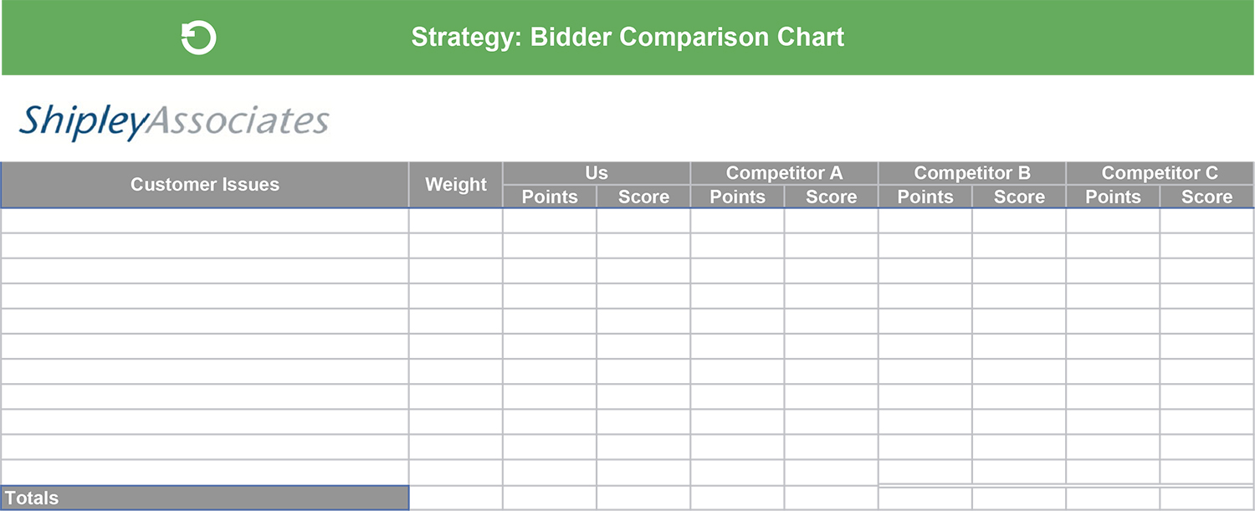
EXTERNAL ANALYSIS
Bidder Comparison
Notes:
Issues
Use the same list of issues from prior competitive analysis.
Update your analysis regularly.
List all issues before moving to subsequent columns.
Weight
Establish weights based on customer-perceived relative importance.
Consider the following weighting scheme: 1 = needed; 2 = important; 3 = most important. Other scales are acceptable if you have the knowledge to satisfactorily differentiate importance of issues to the customer.
Points
Rank your organization and each competitor on a consistent scale.
Various weights are acceptable, such as the evaluation criteria weights when available.
Here is a potential scale to rank your position and competitors’ positions:
1–2 = Problem area. Must be improved. Grounds for elimination.
3–4 = Needs improvement. Cause for concern. Negative trend.
5–6 = Average. Adequate. O.K. if customer is seeking marginally compliant solution.
7–8 = Better than average. Strong performance.
9–10 = Substantially exceeds requirements or expectations.
Score
Multiply the weight by the points for the issue score.
Totals
Total the columns.
Compare the relative totals. Do they make sense? If not, are you missing an issue? Is the issue weighting too high or too low?
Avoid changing weights and rankings to get the desired result.
Review with a knowledgeable, independent authority, if possible.

Slide 15
INTERNAL ANALYSIS
Our Estimate of Winning Price
Customer Budget
Total available funds Timing Types and sources of funds
Customer Expectations
Independent cost estimates Should-cost models Prior purchase prices
Estimated Price to Win
Upper and lower limits on price and capability Cost versus price Acquisition, total installed, total life cycle, or annualized cost
Low Cost
Minimally acceptable capability Your organization’s low-cost approach Credible competitors’ approaches
Best Value
Capability satisfied solution Optimal price-capability tradeoff Value proposition
Notes:
Customer Budget
Summarize the customer’s available budget for the purchase, not total budget for the project. The purchase budget excludes acquisition and internal implementation costs.
Consider budget timing and cash flow.
Note the type and source of funds, when relevant (capital investment, operational, budgeted, requested in future budgets).
Customer Expectations
Consider independent cost estimates by the customer or consultants.
Apply should-cost or parametric pricing models.
Determine prior purchase prices by this customer for similar products or services.
Low Cost
Identify and price the minimally acceptable capability.
Determine the lowest cost approach for your organization.
Consider how competitors could achieve lower prices.
Best Value
Conduct a price-capability trade-off to estimate the customer’s willingness to pay more for additional capability. A customer will sometimes pay a margin above a minimum-capability solution’s price, but usually no more than 10–15 percent.
Create a value proposition tailored to the customer’s needs. Include a quantified business benefit, timing, and costs of the benefits, a calculated payback period, and methods for measuring results.
Estimated Price to Win
Identify and price the capability-satisfied solution.
List the customer’s probable upper and lower price limits at desired, specified, acceptable, and minimum capability levels. What price is too low to be credible or too high to be affordable?
Note whether the customer has the flexibility to accept solutions below the specified capability.
Does the customer care about your perceived margins and underlying cost, or only total price?
Does the price to win need to consider costs/prices in special ways to satisfy the customer, such as total installed, lifecycle, or annualized costs/prices?

Slide 16
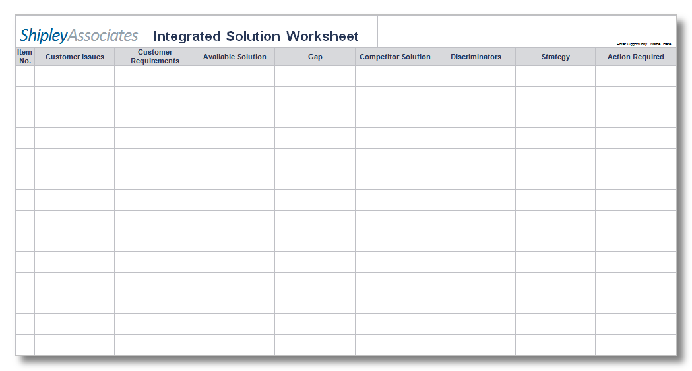
INTERNAL ANALYSIS
Our Technical/Management Solution
Notes:
Customer issues
Transfer the issues listed on the Bidder Comparison Chart.
Customer requirements
List known or probable requirements linked to customer issues.
If you see issues without corresponding requirements, consider what might be required.
If you see requirements without corresponding issues, consider:
Have you missed potential issues?
Have you erroneously persuaded yourself that something you hope to sell is needed or wanted by this customer? Do you have a solution in search of a customer?
Available solution
List what you have available now.
Update as you develop or refine your solution as requirements evolve.
Gap
Note the difference between what is required and your available solution, whether positive or negative. This gap becomes a potential discriminator.
Competitor solution
List the best competitor’s probable solution to each requirement.
Discriminators
List features of your solution that differ from the features of one or more of the competitors’ solutions.
The more important the issue and the greater the difference, the more important the discriminator.
Strategy
List the potential positions that you might take to:
Emphasize your strengths.
Mitigate your weaknesses.
Neutralize competitors’ strengths.
Highlight competitors’ weaknesses.
Action required
List potential tactical actions that help persuade the customer to accept your strategy or position.
Because space is limited, expand these actions later when preparing detailed strategy implementation action plans.
Listing a potential tactic does not commit you to take the action. Implement only those actions that will have the greatest impact within the parameters of your resources, schedule, and the rules of the competition.

Slide 17
INTERNAL ANALYSIS
Teaming and Subcontracting
Partner Strategy |  | Partner A | Partner B | Partner C
Partner Selection Criteria | Partner will be prime or subcontractor Partner’s workstream or workshare on the opportunity Partner’s strategic value (other)
Partner Selection Criteria | Customer alignment/relationship Partner’s industry focus Partner’s technology expertise Partner’s value proposition How does the partner help increase our Pwin?
Partner Risks | Is the partner vetted in the supplier management system? Is the partner involving any IP in this engagement? Is the partner bidding with others on this opportunity? (other)
Partner Contracts | NDA in place Teaming agreement/MOU executed SOW Direct contract with customer Past performance documentation Other contracts (e.g., enterprise agreement, software contracts, hardware) (other)
Notes:
Partner
List the organization and point of contact.
Role and work share
List their role and agreed work share, if any.
Rationale
Indicate why each teaming partner was selected from the prime’s perspective. Possible rationales include:
Solicitation requirement.
Gap in your solution (technical, price, support advantage).
Meeting small, minority, or disadvantaged business contracting goals.
Unique technical or management skills.
Positive position with the customer.
Currently on incumbent’s team.
Recommended or requested by the customer.
Eliminate them from competitors’ teams.
Conversely, indicate why the teaming partners either selected or agreed to team with the prime. Use these justifications to position your team as the preferred team.

Slide 18
STRATEGY DEVELOPMENT
Leverage Our Strength
We will leverage our strength in: | By taking these actions: | To achieve:
POSITION | TACTICS | IMPROVED POSITION
POSITION | TACTICS | IMPROVED POSITION
POSITION | TACTICS | IMPROVED POSITION
POSITION | TACTICS | IMPROVED POSITION
Notes:
Strategy statements in a capture plan comprise two elements:
Your desired position: your goal, how you want to be perceived by the customer.
The tactical actions that you will take to improve your position with the customer.
When fully defined in action plans, the tactical actions specify who takes the actions and when they will be taken.
Later, when you begin planning your proposal, you will convert capture strategy statements into proposal strategy statements. The goals will be the same, but the tactical implementation will be about things written or displayed in a verbal presentation; thus, persuading the customer to accept your position.
The first two strategy-development pages are specific to your strengths and weaknesses. The second two reflect competitors’ strengths and weaknesses. Often they overlap, as emphasizing your strength often simultaneously high­lights a competitor’s weakness.

Slide 19
STRATEGY DEVELOPMENT
Mitigate Our Weakness
We will mitigate our weakness in: | By taking these actions: | To achieve:
POSITION | TACTICS | IMPROVED POSITION
POSITION | TACTICS | IMPROVED POSITION
POSITION | TACTICS | IMPROVED POSITION
POSITION | TACTICS | IMPROVED POSITION
Notes:
Strategy statements in a capture plan comprise two elements:
Your desired position: your goal, how you want to be perceived by the customer.
The tactical actions that you will take to improve your position with the customer.
When fully defined in action plans, the tactical actions specify who takes the actions and when they will be taken.
Later, when you begin planning your proposal, you will convert capture strategy statements into proposal strategy statements. The goals will be the same, but the tactical implementation will be about things written or displayed in a verbal presentation; thus, persuading the customer to accept your position.
The first two strategy-development pages are specific to your strengths and weaknesses. The second two reflect competitors’ strengths and weaknesses. Often they overlap, as emphasizing your strength often simultaneously high­lights a competitor’s weakness.

Slide 20
STRATEGY DEVELOPMENT
Exploit Competitor’s Weakness
We will exploit our competitor’s weakness in: | By taking these actions: | To achieve:
POSITION | TACTICS | IMPROVED POSITION
POSITION | TACTICS | IMPROVED POSITION
POSITION | TACTICS | IMPROVED POSITION
POSITION | TACTICS | IMPROVED POSITION
Notes:
Strategy statements in a capture plan comprise two elements:
Your desired position: your goal, how you want to be perceived by the customer.
The tactical actions that you will take to improve your position with the customer.
When fully defined in action plans, the tactical actions specify who takes the actions and when they will be taken.
Later, when you begin planning your proposal, you will convert capture strategy statements into proposal strategy statements. The goals will be the same, but the tactical implementation will be about things written or displayed in a verbal presentation; thus, persuading the customer to accept your position.
The first two strategy-development pages are specific to your strengths and weaknesses. The second two reflect competitors’ strengths and weaknesses. Often they overlap, as emphasizing your strength often simultaneously high­lights a competitor’s weakness.

Slide 21
STRATEGY DEVELOPMENT
Neutralize Competitor’s Strength
We will neutralize our competitor’s strength in: | By taking these actions: | To achieve:
POSITION | TACTICS | IMPROVED POSITION
POSITION | TACTICS | IMPROVED POSITION
POSITION | TACTICS | IMPROVED POSITION
POSITION | TACTICS | IMPROVED POSITION
Notes:
Strategy statements in a capture plan comprise two elements:
Your desired position: your goal, how you want to be perceived by the customer.
The tactical actions that you will take to improve your position with the customer.
When fully defined in action plans, the tactical actions specify who takes the actions and when they will be taken.
Later, when you begin planning your proposal, you will convert capture strategy statements into proposal strategy statements. The goals will be the same, but the tactical implementation will be about things written or displayed in a verbal presentation; thus, persuading the customer to accept your position.
The first two strategy-development pages are specific to your strengths and weaknesses. The second two reflect competitors’ strengths and weaknesses. Often they overlap, as emphasizing your strength often simultaneously high­lights a competitor’s weakness.

Slide 22
ACTION PLANS
Customer Contact Plan
Contact Objective | Who | When | Where | Cost | Status/ Comments
Initial capability briefing to customer’s chief engineer | M. Johnson | April 1, 20XX | DOT Test Laboratory | $1,800 Travel | Delayed till May 15
Notes:
The analysis and planning process documented in a capture plan is useless until action is taken. Assigning positioning actions, assessing outcomes, and then adapting subsequent tasks based upon results is the essential role of the capture manager.
One key difference between typical roles of a capture manager and sales professional is that a capture manager coordinates the positioning activities of a large capture team, often including senior management personnel. Most sales professionals focus primarily on individual selling tasks, with less emphasis on managing others to participate in the positioning or selling.
Action plans specify activities to be performed, objectives to be met, assigned personnel, deadlines, locations, costs, and status. Contingencies should be anticipated, and risks must be characterized and mitigated. Adjust the format and content of action plans to circumstances of the opportunity and task management practices of the organization. Use existing scheduling and task management tools to manage capture activities, which are really just important organizational projects.
The sample action plans shown include representative entries. The level of detail shown is usually adequate for management review. Capture team members usually need more detailed information to successfully meet task objectives.

Slide 23
ACTION PLANS
Intelligence Collection Plan
Intelligence Objective | Assigned to | Who | When | Where | Cost | Status/ Comments
Determine funding level for next FY budget | T. Ferguson | DC Staff | March 15, 20XX | Talk to congr. staff | None (OH) | On track
Notes:
The analysis and planning process documented in a capture plan is useless until action is taken. Assigning positioning actions, assessing outcomes, and then adapting subsequent tasks based upon results is the essential role of the capture manager.
One key difference between typical roles of a capture manager and sales professional is that a capture manager coordinates the positioning activities of a large capture team, often including senior management personnel. Most sales professionals focus primarily on individual selling tasks, with less emphasis on managing others to participate in the positioning or selling.
Action plans specify activities to be performed, objectives to be met, assigned personnel, deadlines, locations, costs, and status. Contingencies should be anticipated, and risks must be characterized and mitigated. Adjust the format and content of action plans to circumstances of the opportunity and task management practices of the organization. Use existing scheduling and task management tools to manage capture activities, which are really just important organizational projects.
The sample action plans shown include representative entries. The level of detail shown is usually adequate for management review. Capture team members usually need more detailed information to successfully meet task objectives.

Slide 24
ACTION PLANS
Our Contingency Plan
Event | Probability | Impact | Area (personnel, solution, pricing etc.) | Response | Status/ Comments
Preferred vendor will not team | Low | Medium | Pricing | Manufacture parts in-house | Pilot production completed
Notes:
The analysis and planning process documented in a capture plan is useless until action is taken. Assigning positioning actions, assessing outcomes, and then adapting subsequent tasks based upon results is the essential role of the capture manager.
One key difference between typical roles of a capture manager and sales professional is that a capture manager coordinates the positioning activities of a large capture team, often including senior management personnel. Most sales professionals focus primarily on individual selling tasks, with less emphasis on managing others to participate in the positioning or selling.
Action plans specify activities to be performed, objectives to be met, assigned personnel, deadlines, locations, costs, and status. Contingencies should be anticipated, and risks must be characterized and mitigated. Adjust the format and content of action plans to circumstances of the opportunity and task management practices of the organization. Use existing scheduling and task management tools to manage capture activities, which are really just important organizational projects.
The sample action plans shown include representative entries. The level of detail shown is usually adequate for management review. Capture team members usually need more detailed information to successfully meet task objectives.

Slide 25
ACTION PLANS
Solution Development Plan (if required)
Solution Element | Assigned to | Who | Need Date | Cost | Status/ Comments
Demonstrate 1GB/sec autonomous data transfer rate | P. Patterson | Dept. H1610 | Sept. 15, 20XX | $75K (IR&D) | Auto-synch may delay
Notes:
The analysis and planning process documented in a capture plan is useless until action is taken. Assigning positioning actions, assessing outcomes, and then adapting subsequent tasks based upon results is the essential role of the capture manager.
One key difference between typical roles of a capture manager and sales professional is that a capture manager coordinates the positioning activities of a large capture team, often including senior management personnel. Most sales professionals focus primarily on individual selling tasks, with less emphasis on managing others to participate in the positioning or selling.
Action plans specify activities to be performed, objectives to be met, assigned personnel, deadlines, locations, costs, and status. Contingencies should be anticipated, and risks must be characterized and mitigated. Adjust the format and content of action plans to circumstances of the opportunity and task management practices of the organization. Use existing scheduling and task management tools to manage capture activities, which are really just important organizational projects.
The sample action plans shown include representative entries. The level of detail shown is usually adequate for management review. Capture team members usually need more detailed information to successfully meet task objectives.

Slide 26
ACTION PLANS
Customer Risk Management Plan
Risk Area | Probability | Impact | Likelihood | Mitigation plan | Management Approach | Status/ Comments
Vendor cannot deliver on time | Medium | High | low | Back up vendors | Dual source for all components | Secondary sources identified

Slide 27
EXECUTION AND MONITORING
Additional links/elements
Capture team organization chart
Schedule (if needed to augment action plans)
  Kickoff meeting
  Management reviews
  Key milestones from action plans
Budget (in required corporate format)
Customer organization/ stakeholder analysis
Business and win potential
Resource plan
Teaming partner analysis
Draft solution design
27
Notes:
Include attachments appropriate to your organization. These items might be physically attached or shown as electronic links to a secure website. If you prefer, incorporate them into the body of the capture plan. The list shown in the sample is illustrative but not exhaustive. In general, the largest opportunities will require the most additional information.

